Slide 1
Portable Ultrasound Device (PUD) for Coda-Wave Interferometry
Spring ‘24
Sprint 6
Prepared by Michael Kisellus, Christopher Coppedge,
Leyton Foxworthy, Matthew Baker, Kyle Fox
Product owner : Dr. Brown
16 APR 2024

Slide 2
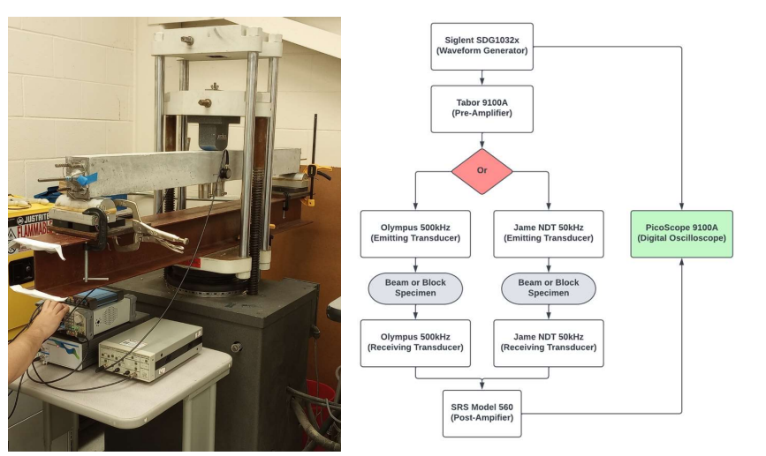
Introduction - Background
Civil engineering lab has a concrete “scanning” process that involves measuring how ultrasonic waves travel through the concrete

Slide 3
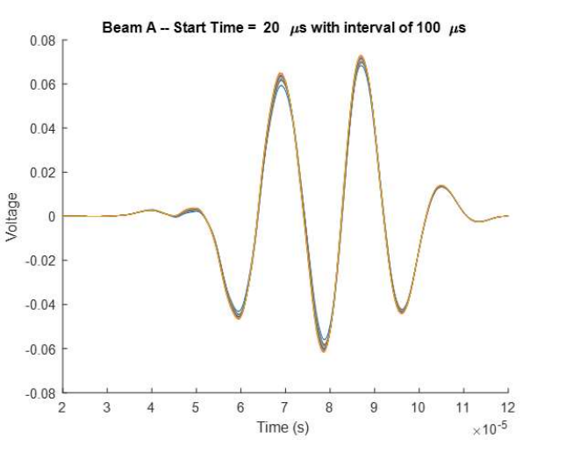
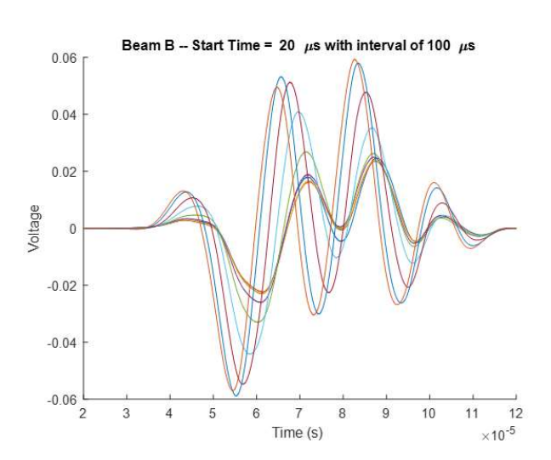
Introduction - Background
Data analysis, can reveal imperfections in the concrete.
Scan of an undamaged section of concrete
Scan of a compromised section of concrete

Slide 4
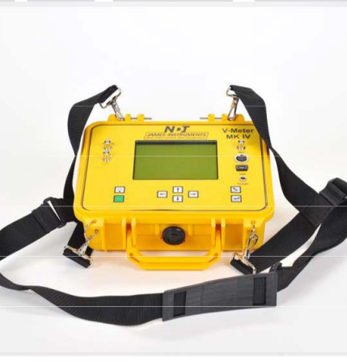
Introduction - Purpose
Produce a handheld ultrasound inspection device for inspecting a bridge/structural component for faults in the field.
Inspection Unit gathers and stores test data collected over time (48 to 72 hours).
Budget - $2000
Rationale:
Existing commercial solution is expense (~ 5000 USD)
Existing solution cannot operate without operator present.

Slide 5

Introduction - Purpose
Benefit to society:
More thorough inspections for concrete pillar supporting infrastructure.
This increases safety for publicly used infrastructure such as bridges.

Slide 6

Design Considerations - Assumptions
Ambient temperatures during operation shall not exceed 120° F.
The battery is fully charged before sampling starts.
The battery is in good condition and has not degraded from age.
The unit is placed in a dry location protected from major weather interference.
The unit is used following the user manual.
The user places the transistor transmitter and receiver correctly.
The unit has no component failures.

Slide 7
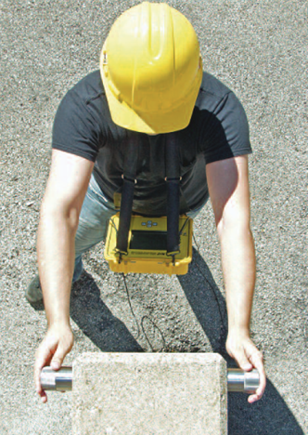
Design Considerations – Requirements and Constraints
The Portable Ultrasound Device (PUD) shall:
Be portable and usable by a single operator.
Initiate testing and record the resulting data.
Operate for 48 to 72 hours without exterior inputs.
Operate in outdoor/ field environment

Slide 8
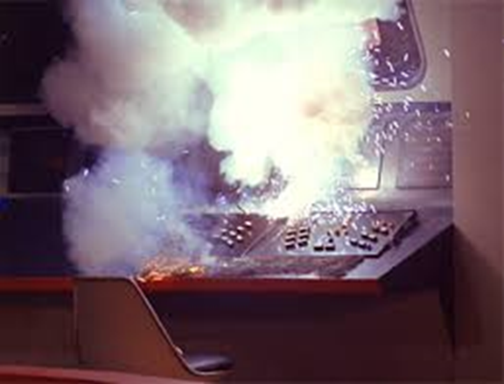
Design Considerations - Risks
Electrical shock (500v)
Electrical component failure

Slide 9

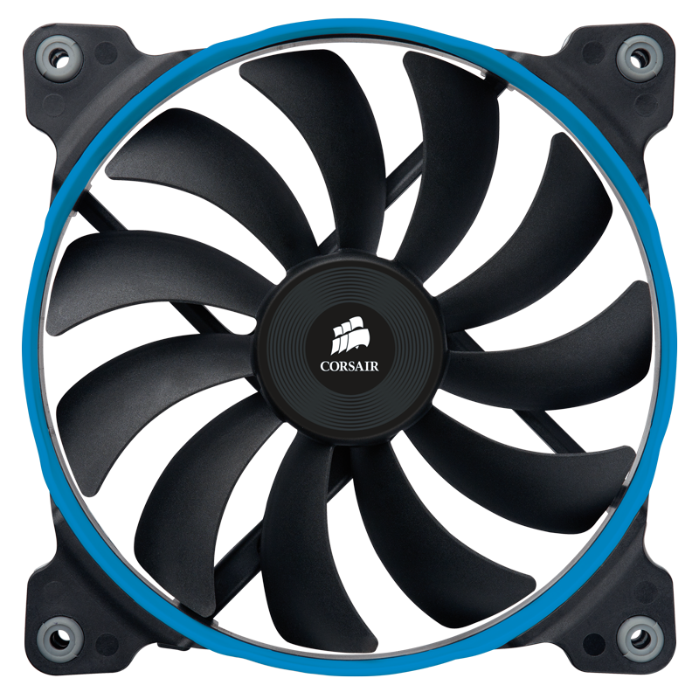


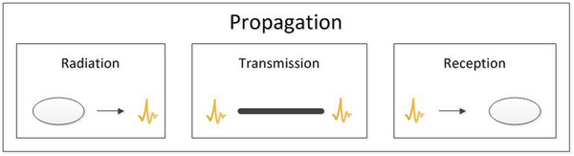
System Architecture – Major Subsystems
Hardware
Electrical system
Enclosure and Mounting system
Cooling system
Software
Transmit (Tx) and Receiver (Rx) system
Control system

Slide 10
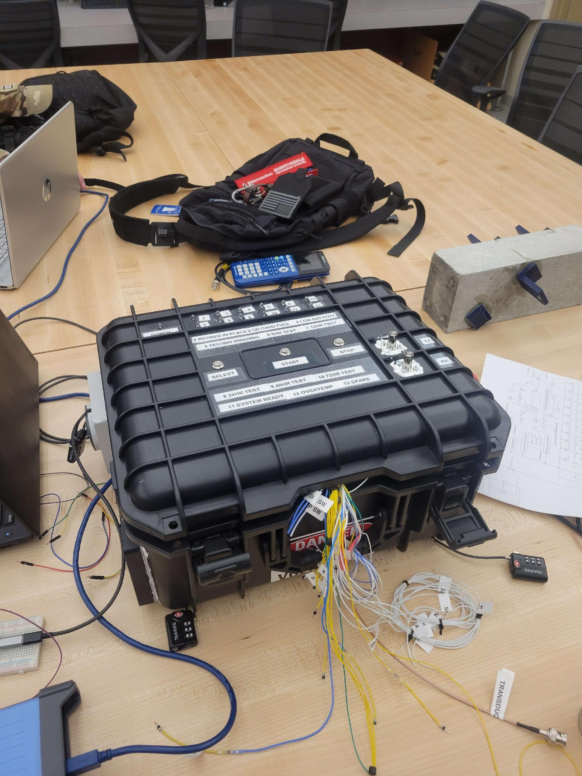
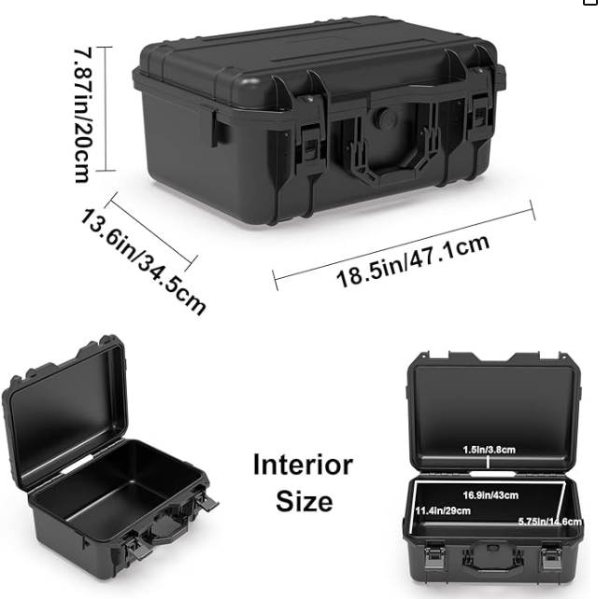
System Architecture – Enclosure And Mounting System
Enclosure
Off the shelf case
Mounting
Velcro, silicone putty, and screws.

Slide 11
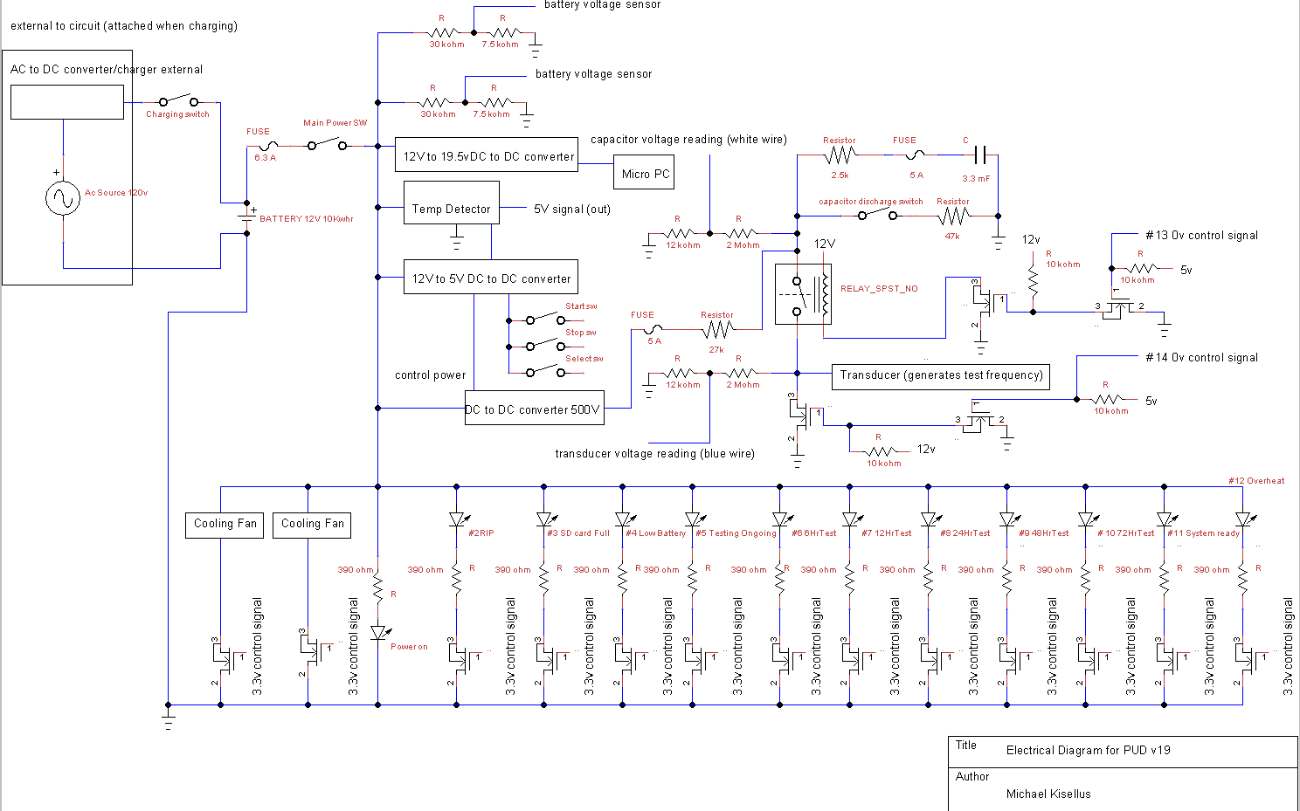
System Architecture – Electrical System
System provides:
5v
12v
19.5v
500v
Ability to sense voltages at test points
Battery charging without removal

Slide 12
Sub-System Design–
Electrical System Low voltage

Slide 13
Sub-System Design–
Electrical System High voltage

Slide 14
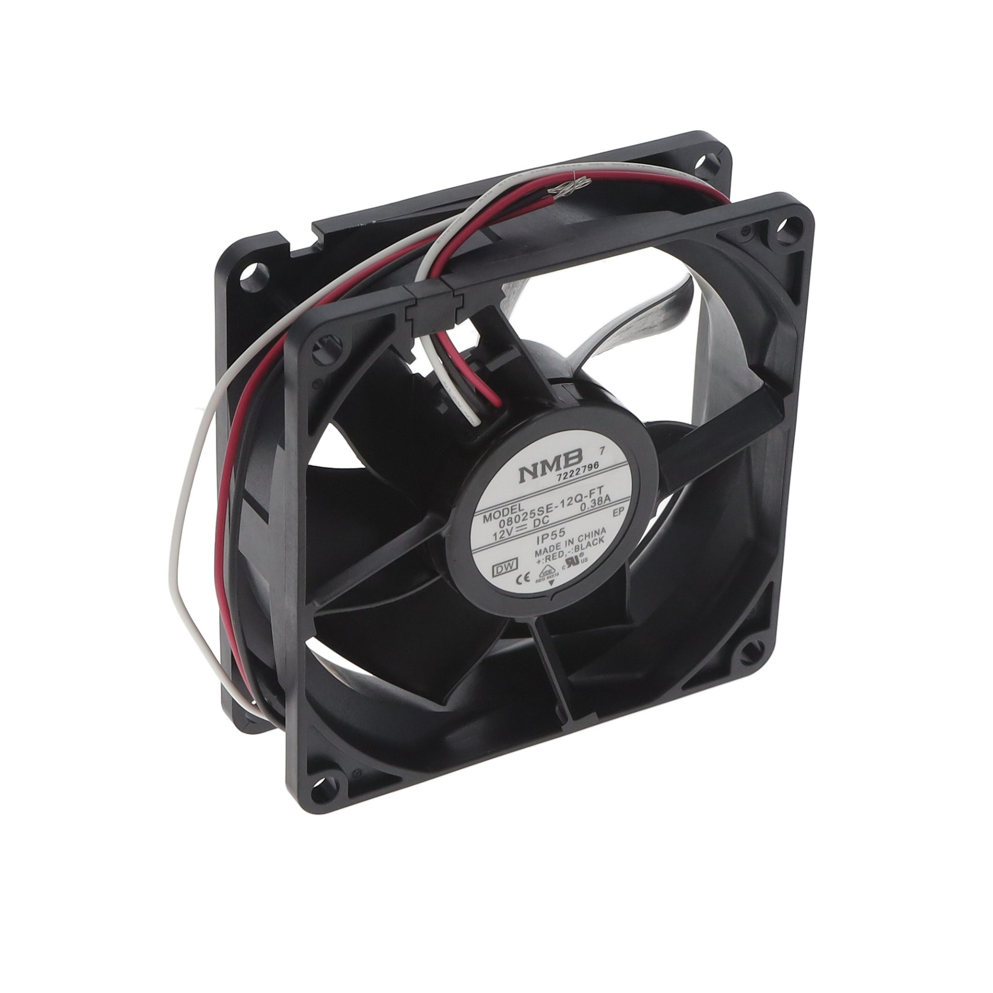
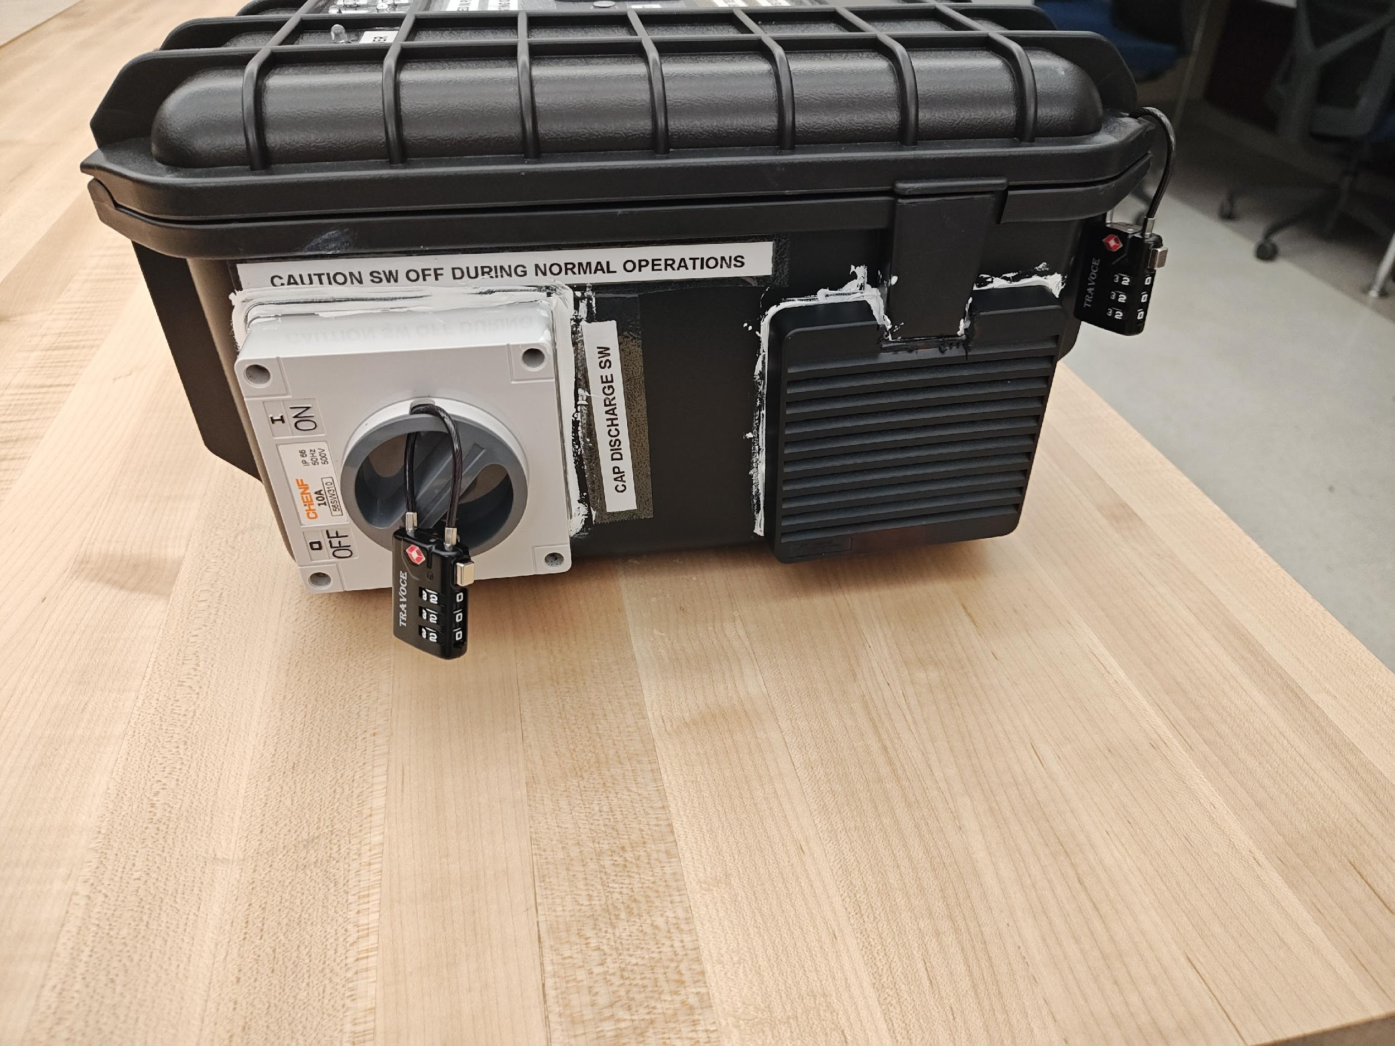
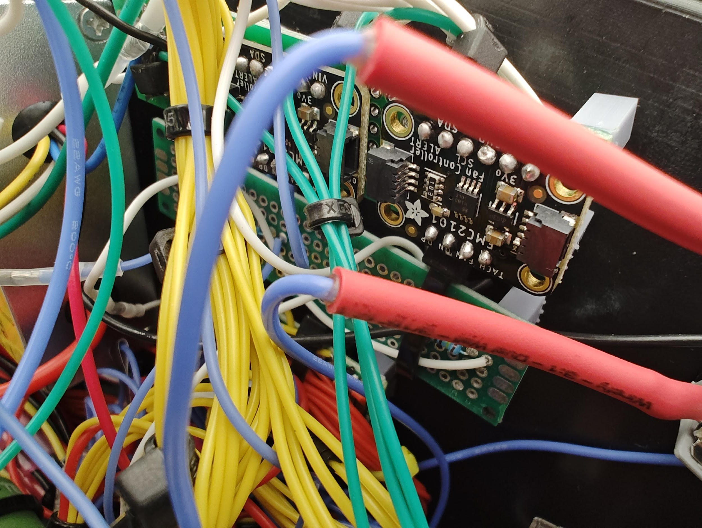
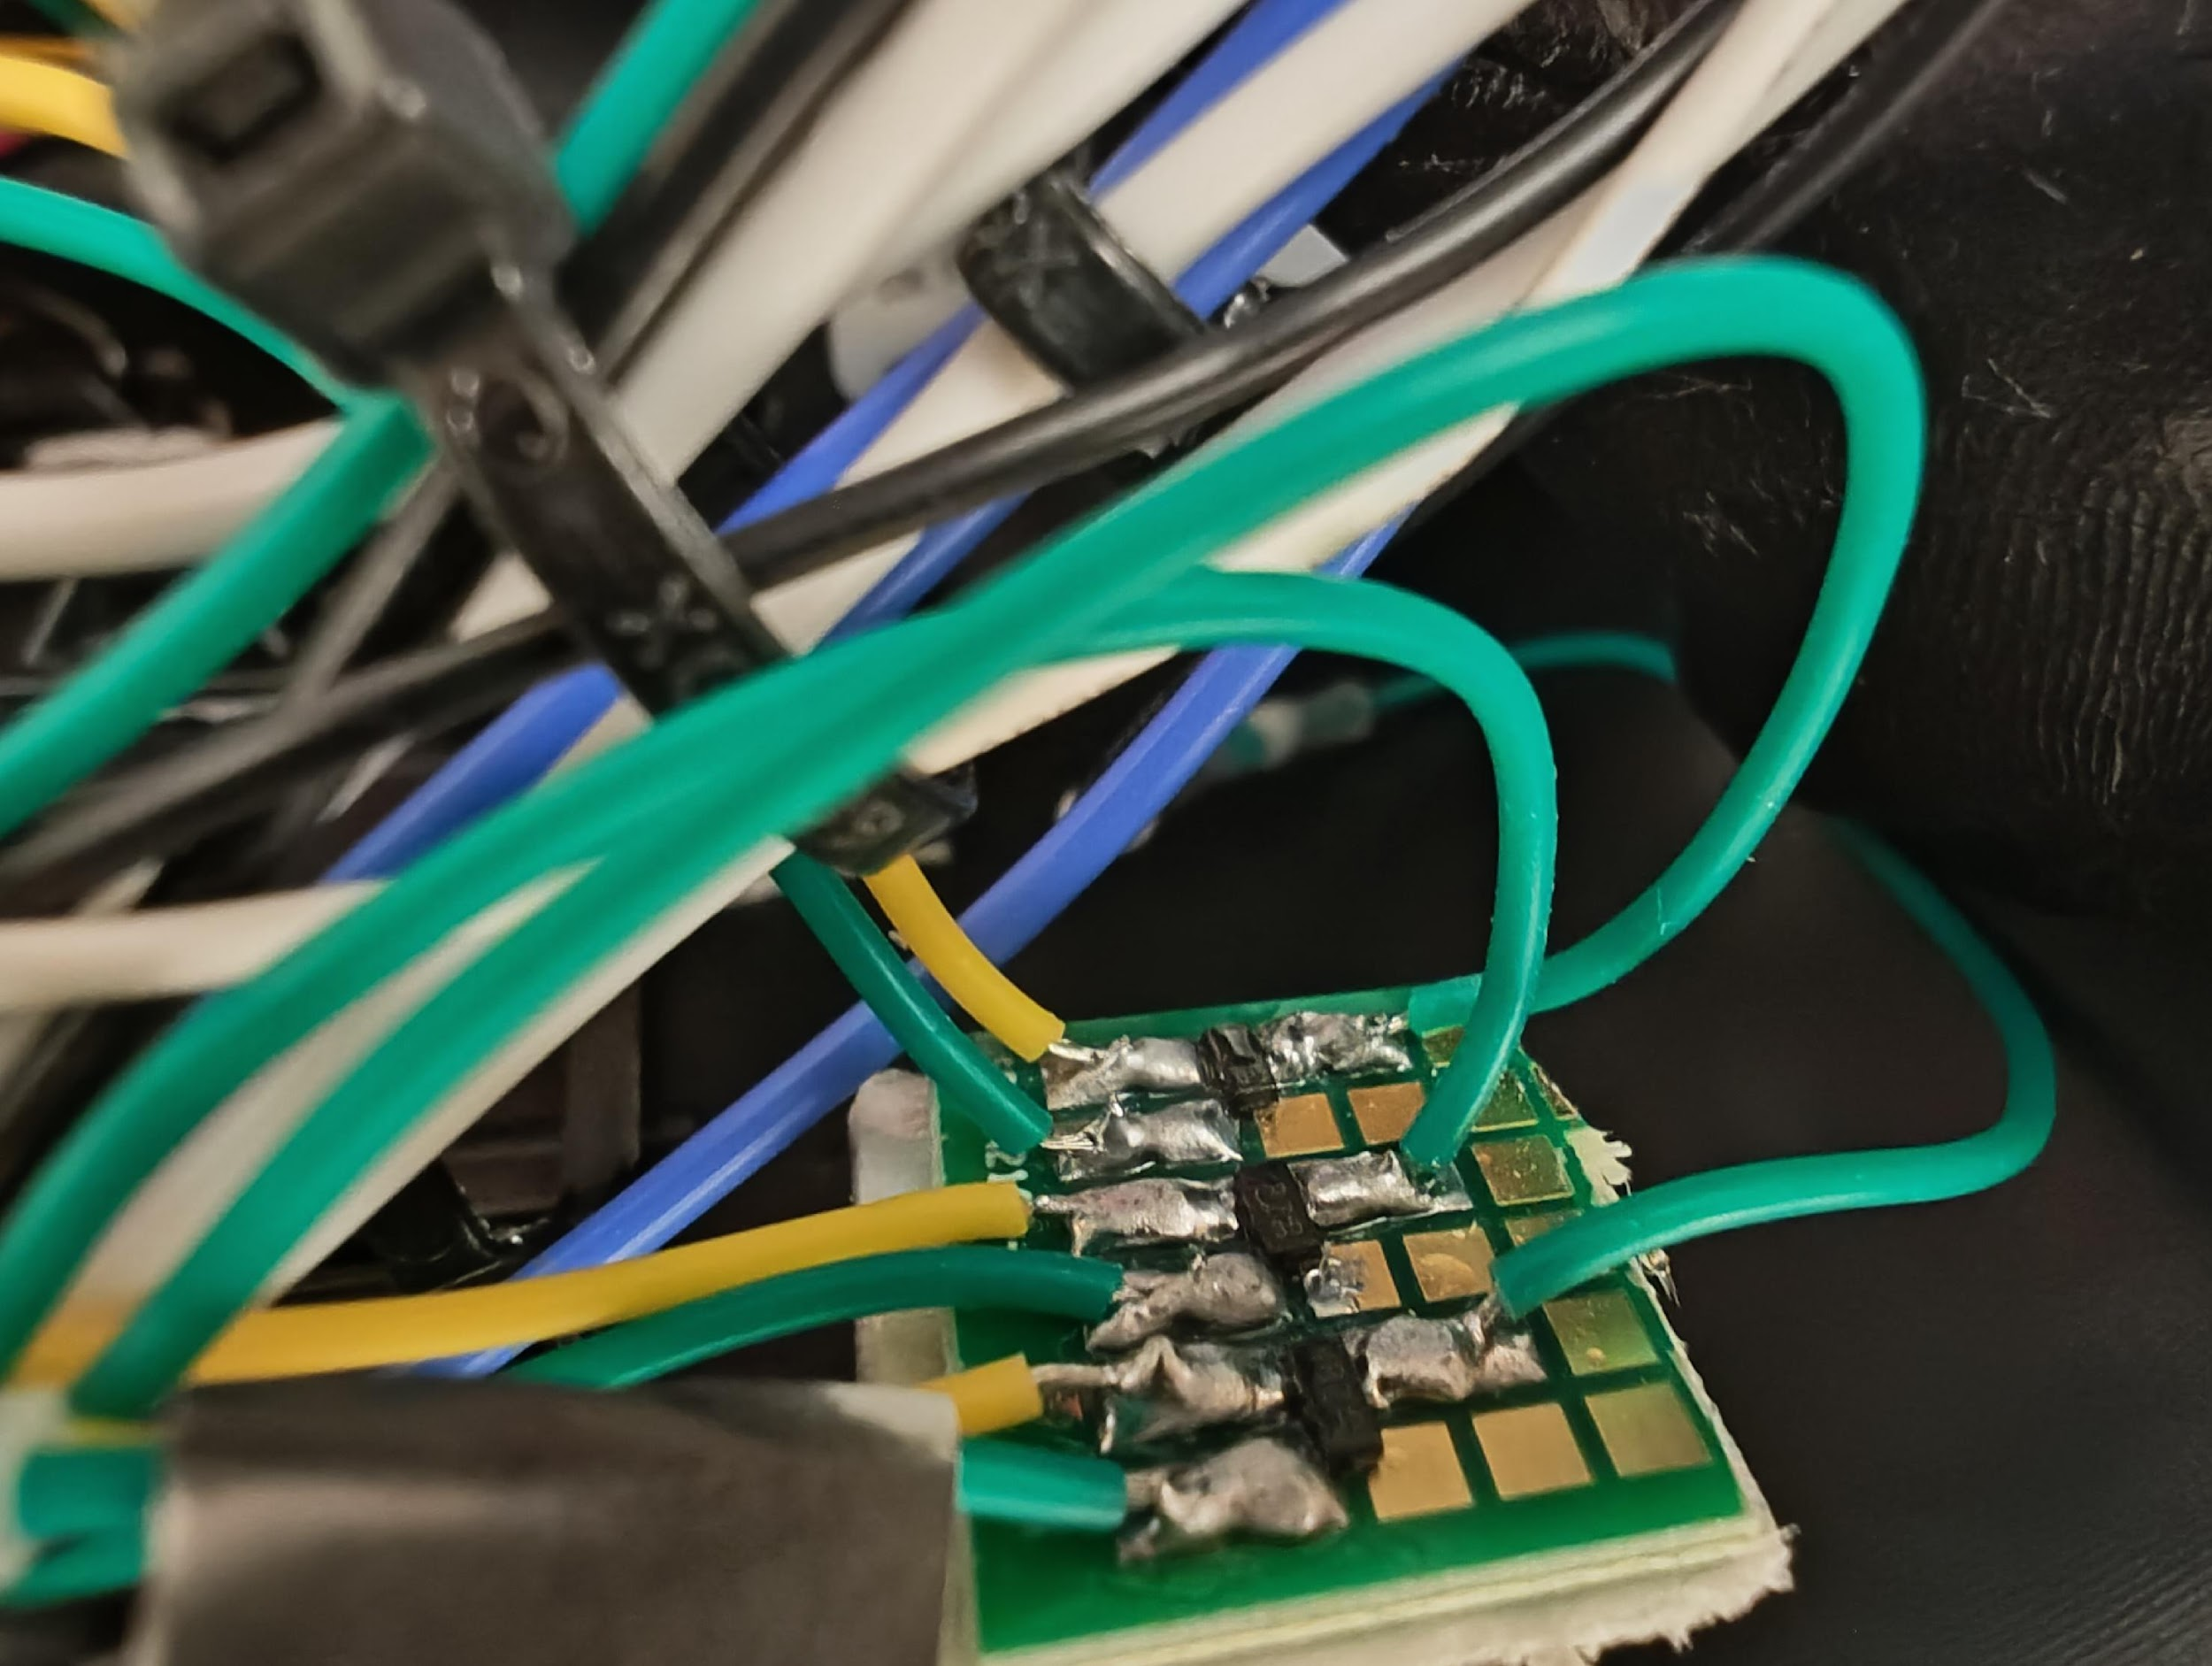
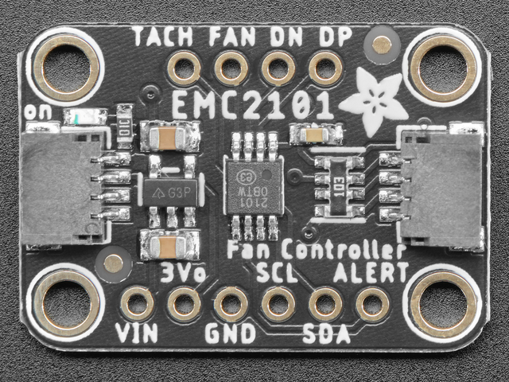
System Architecture – Cooling System
NMB Corp 12VDC, IP55 rated fan
w/ EMC2101 Fan Controller & MOSFET-based on/off trigger

Slide 15
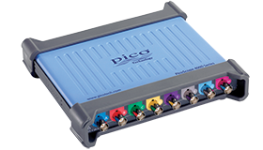
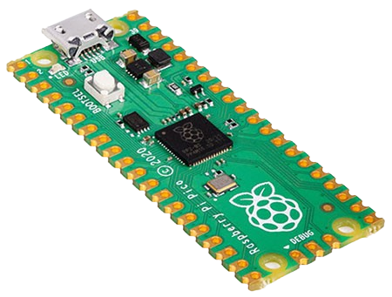
System Architecture –
Tx, Rx, And Control System
Current RX/TX System Status:
RX side is assembled with an oscilloscope connected to a minicomputer to record and process data
TX side is a custom electrical circuit that uses a HV capacitor and MOSFET to pulse the transducer
Control System is a RP2040 that starts the system, times pulses, and total test time

Slide 16

Possible Future Developments
Code development, implementation and improvement
Complete the construction/ add oscilloscope
Reduce weight
Reduce battery size
Reduce capacitor size
Add more receiver probes to test at multiple locations

Slide 17
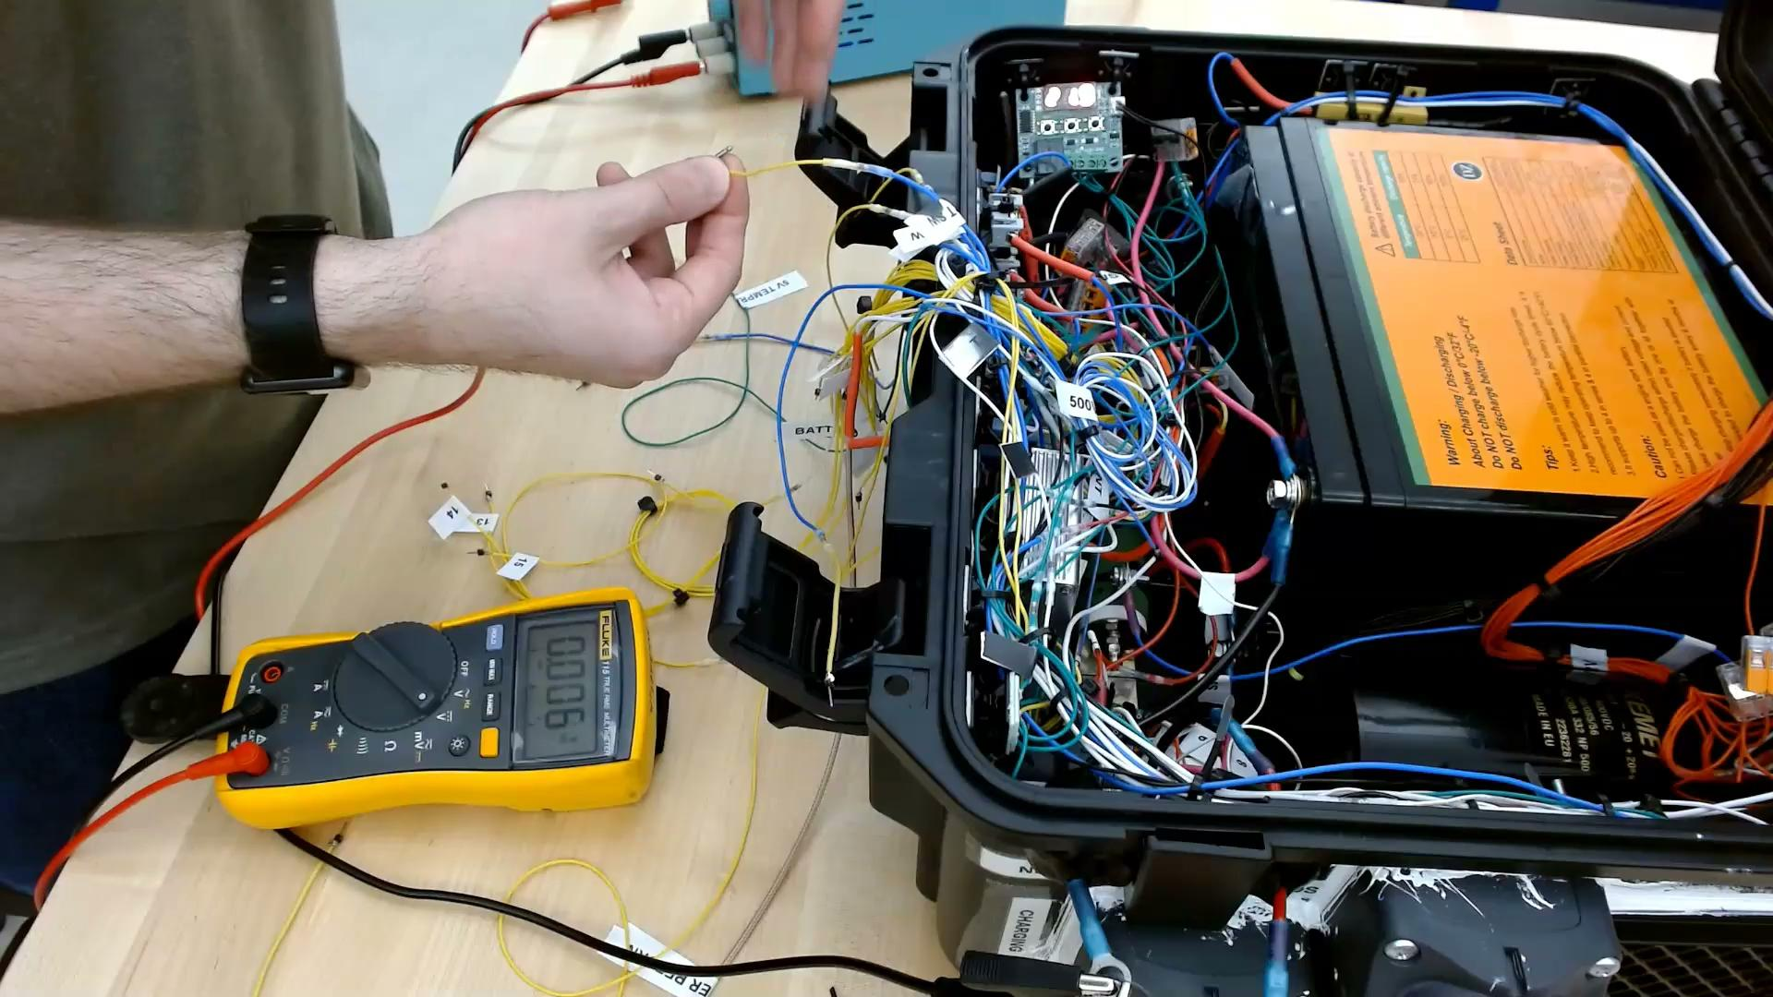
Visual Demo

Slide 18
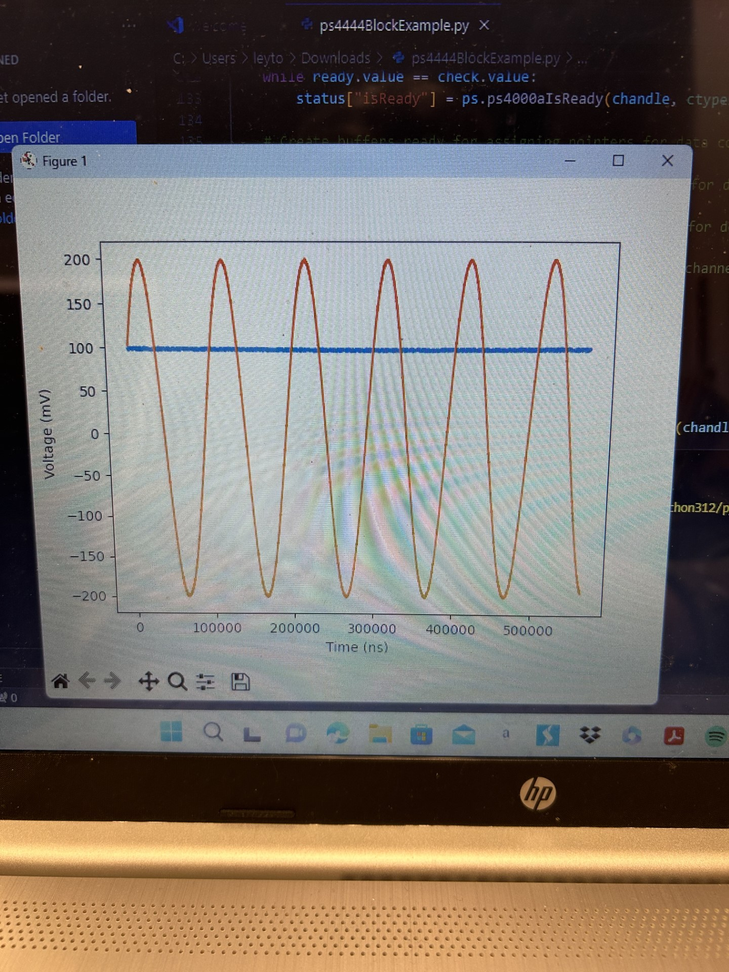
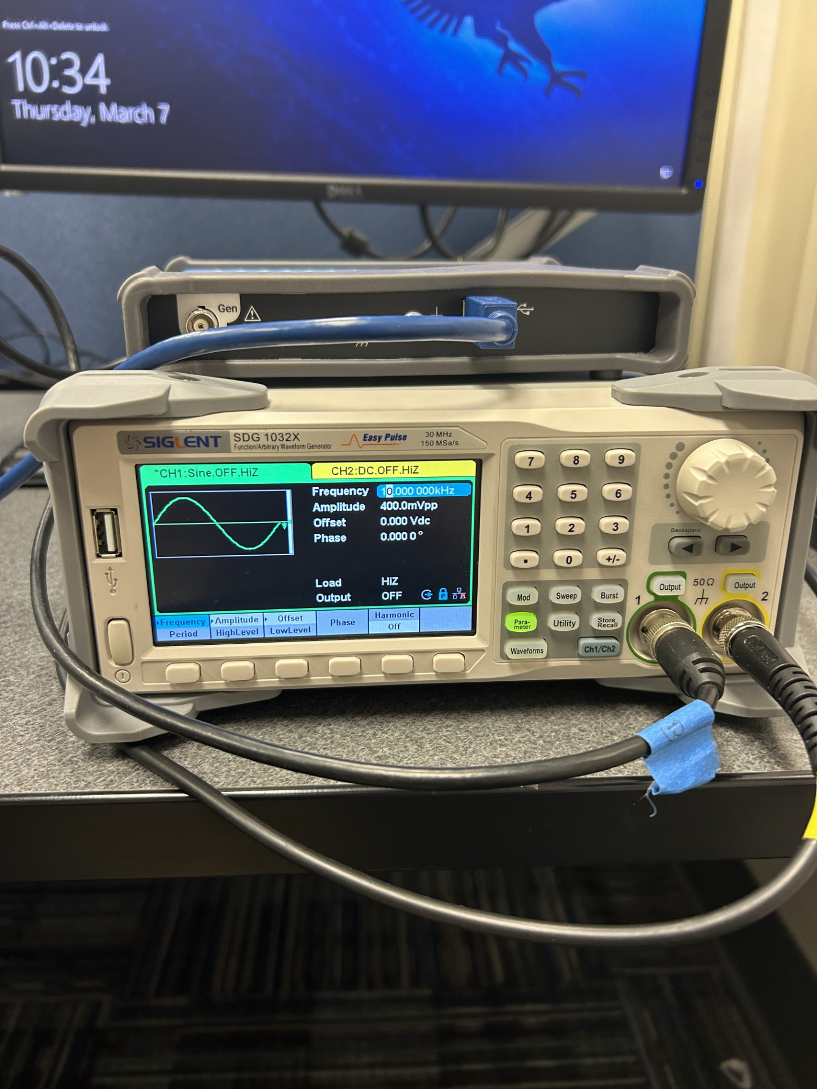
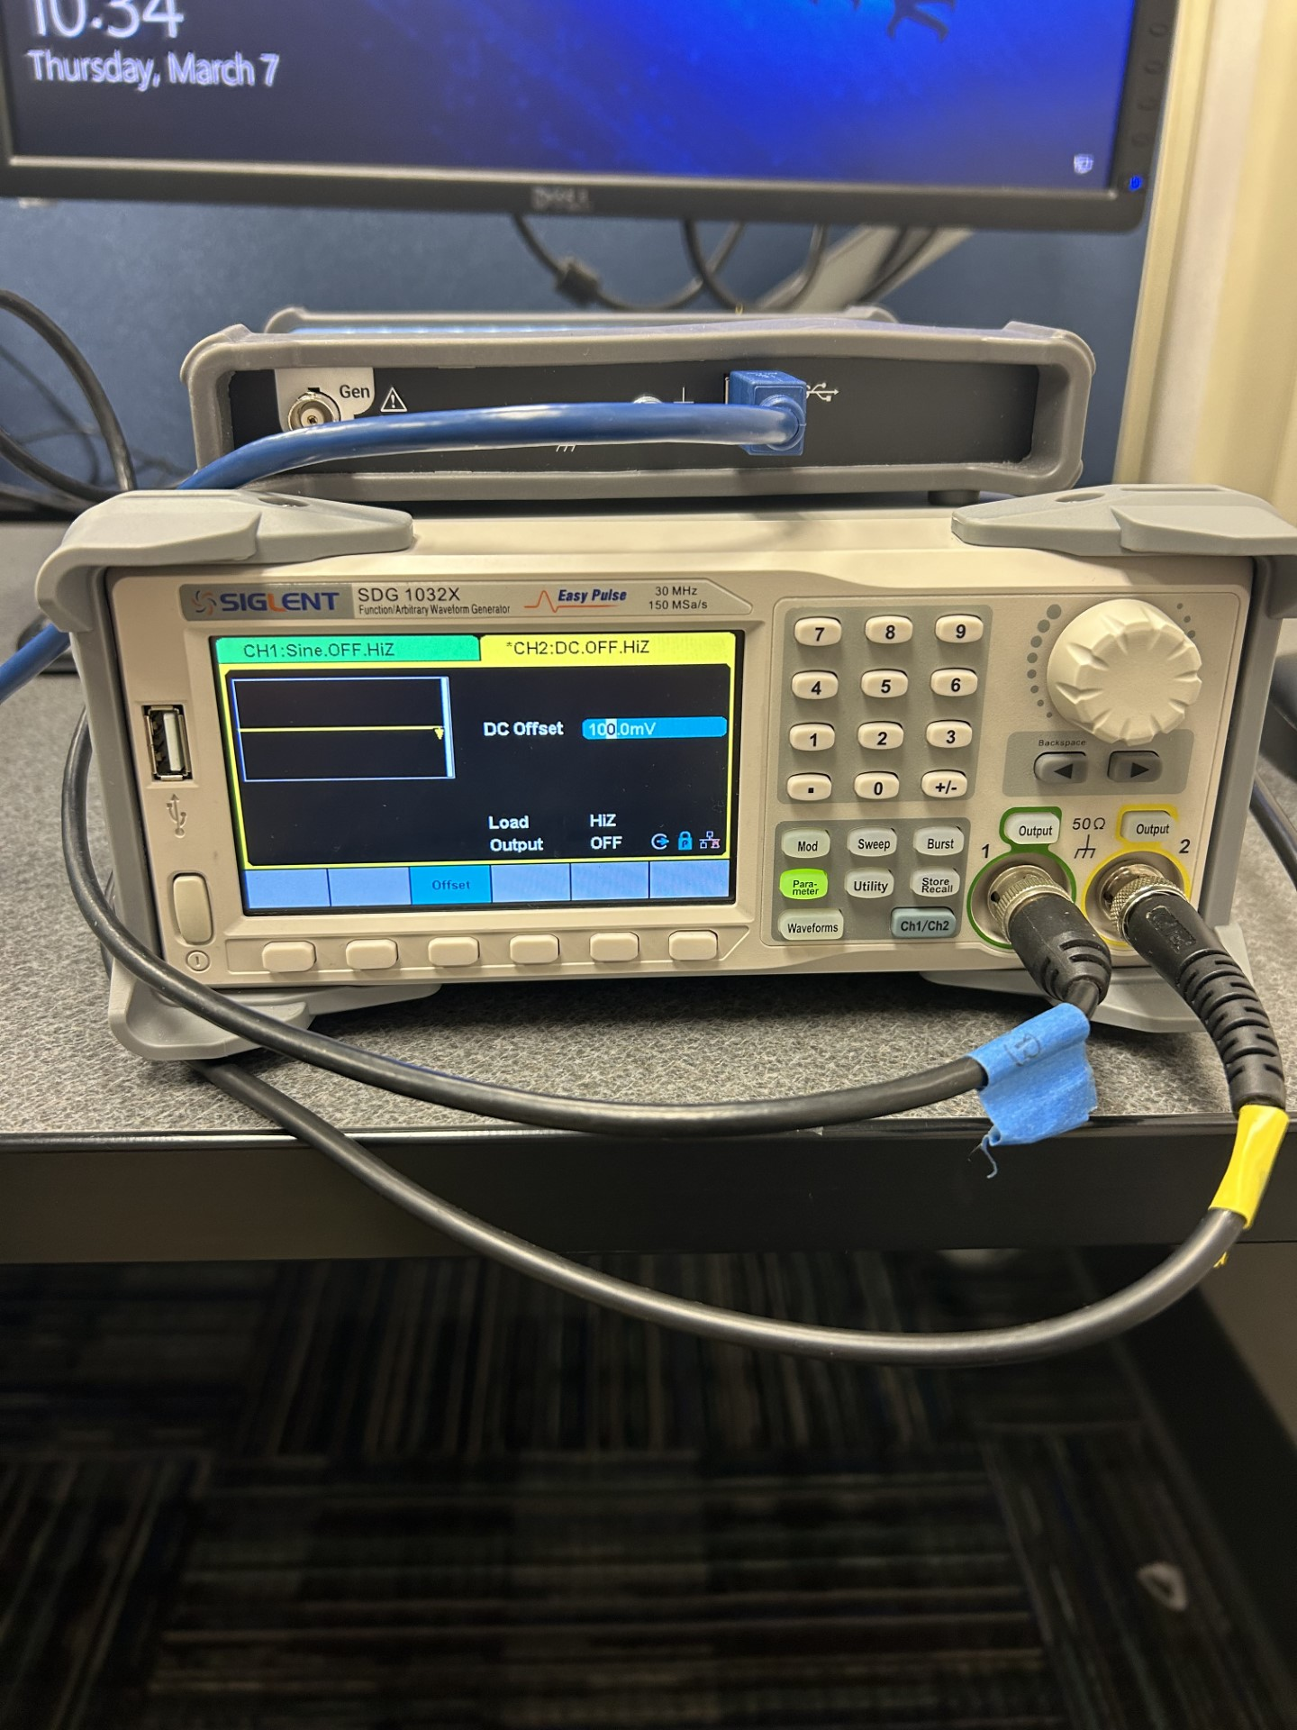
Code Demo

Slide 19


Questions?

